Slide 1

Exploratory Data Analysis
G2M insight for Cab Investment firm Analysis
21-05-2024
Name: Sarima Iyayi
Cohort Code.: LISUM33

Slide 2

Agenda
Executive Summary
Problem Statement
Approach
EDA
EDA Summary
Recommendations

Slide 3
Executive Summary
Introduction:
The objective of this project is to provide a comprehensive analysis of two cab companies, Yellow Cab and Pink Cab, to identify which company is a better investment opportunity for XYZ, a private firm in the US. By leveraging multiple datasets, we aim to deliver actionable insights into market trends, customer demographics, revenue, and profitability.
Objectives:
Analyze demographic and transactional data to understand customer profiles and usage patterns.
Compare the performance metrics of Yellow Cab and Pink Cab in terms of revenue, cost efficiency, and profit margins.
Investigate the impact of holidays on ride demand and revenue generation.
Provide forecasts for future revenue trends for both companies.
Formulate strategic recommendations based on the analysis to guide XYZ's investment decision.
Key Findings:
Yellow Cab has higher revenue and profit margins than Pink Cab.
Yellow Cab serves a broader income range and has better market penetration in major cities.
Pink Cab is more cost-efficient per kilometer traveled.
Recommendations:
Invest in Yellow Cab due to higher profitability and market reach.
Consider strategies to improve cost efficiency for Yellow Cab and increase Pink Cab's market presence.

Slide 4
Problem Statement
XYZ, a private firm in the US, is considering investing in the cab industry. The objective is to identify the better investment opportunity between Yellow Cab and Pink Cab by analyzing customer profiles, market trends, revenue, and profitability using provided datasets and additional external data

Slide 5
APPROACH
Data Collection:
Datasets Used:
Cab Data: Transaction details for Yellow Cab and Pink Cab.
Customer Data: Demographics of customers.
Transaction Data: Mapping of transactions to customers.
City Data: Information on city population and cab users.
Holiday Data: List of US holidays.
Data Cleaning:
Handling Missing Values: Filled missing values, e.g., 'NaN' in holidays replaced with 'None'.
Removing Duplicates: Ensured no duplicate records.
Data Transformation: Converted date fields, merged datasets, and filtered external data to align with cab data.

Slide 6
Exploratory Data Analysis (EDA):
Demographic Analysis: Analyzed age, gender, and income distributions.
Usage Patterns: Studied ride frequency and revenue across cities and time.
Impact of Holidays: Compared ride and revenue data on holidays vs. non-holidays.
Hypothesis Testing:
Statistical Tests:
T-tests: Compared revenue and profit margins.
F-tests: Compared income and profit variability.
Chi-square Tests: Examined incidence of negative profits.
Validated Hypotheses: Revenue, profit margin, cost efficiency, and market penetration differences between Yellow Cab and Pink Cab.
Forecasting:
Time Series Analysis: Used Exponential Smoothing to predict future revenue trends.
Results: Forecasted revenue for both companies, identifying growth and decline periods

Slide 7
Exploratory Data Analysis (EDA)
Demographic Analysis:
Age Distribution by Company
Income Distribution by Company
Gender Distribution by Company
Usage and Market Penetration:
Cab Usage by City and Company
Market Penetration by City and Company
Impact of Holidays:
Number of Rides on Holidays vs. Non-Holidays
Revenue on Holidays vs. Non-Holidays
Forecasts

Slide 8
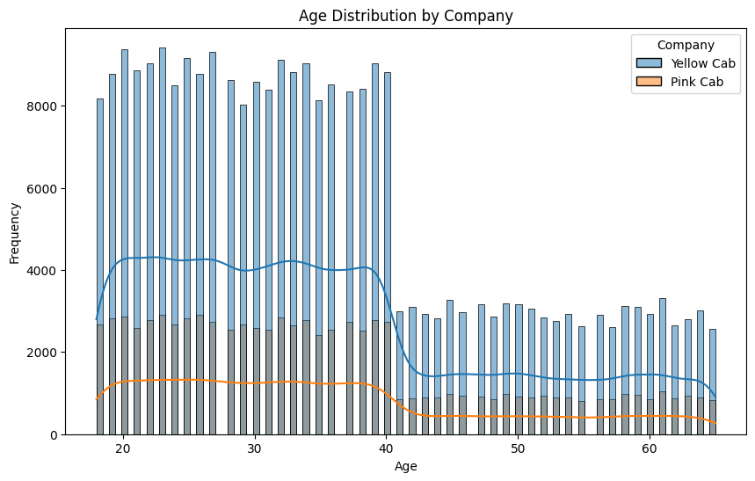
Yellow Cab appears to attract a younger customer base more effectively than Pink Cab, Predominantly serving younger customers with a higher frequency in the age range of 20-40 years.

Slide 9
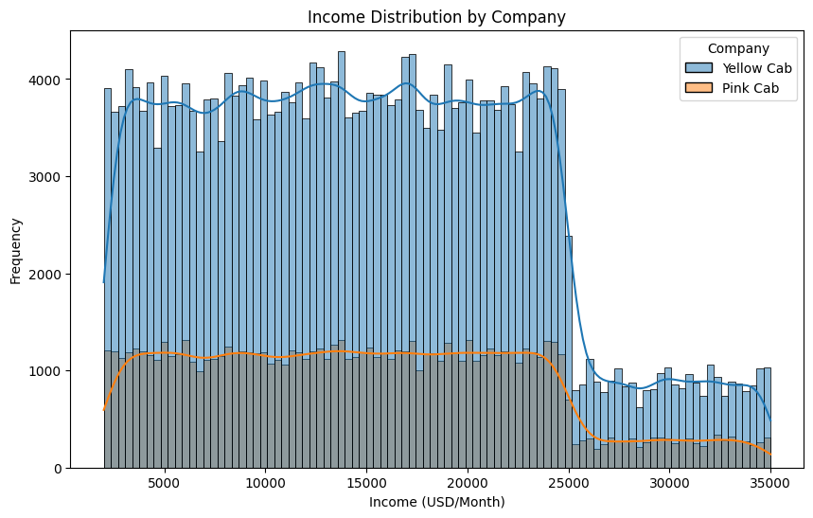
Yellow Cab caters to a broader income range, indicating a wider market reach and potentially better marketing or service offerings that appeal to different income segments.

Slide 10
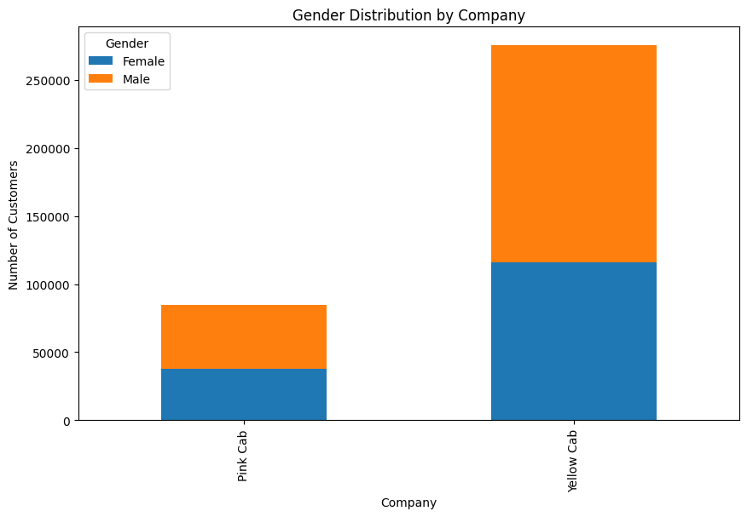
Yellow Cab has a larger customer base for both genders, suggesting a broader appeal

Slide 11
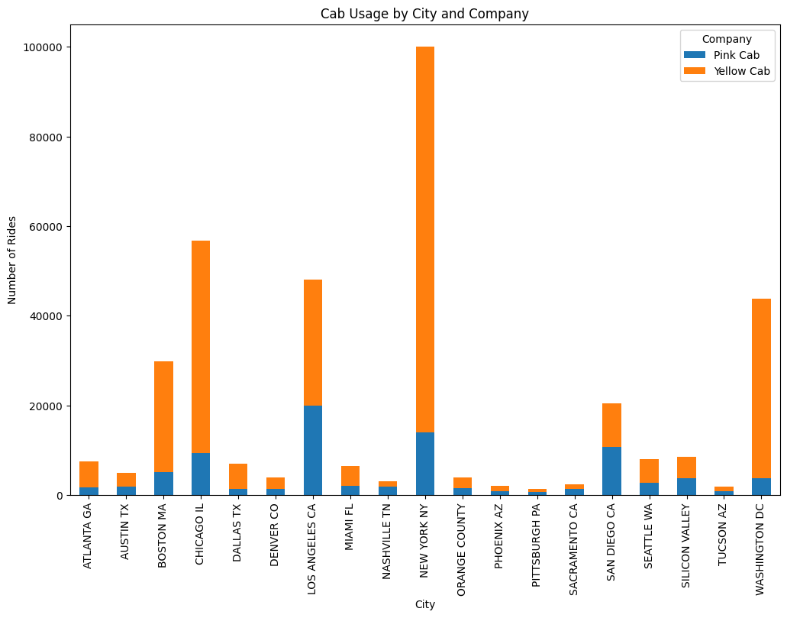
Yellow Cab has a stronger market presence in major cities, particularly high-density urban areas like New York, Chicago, and Los Angeles. This indicating better market penetration and possibly better service coverage.

Slide 12
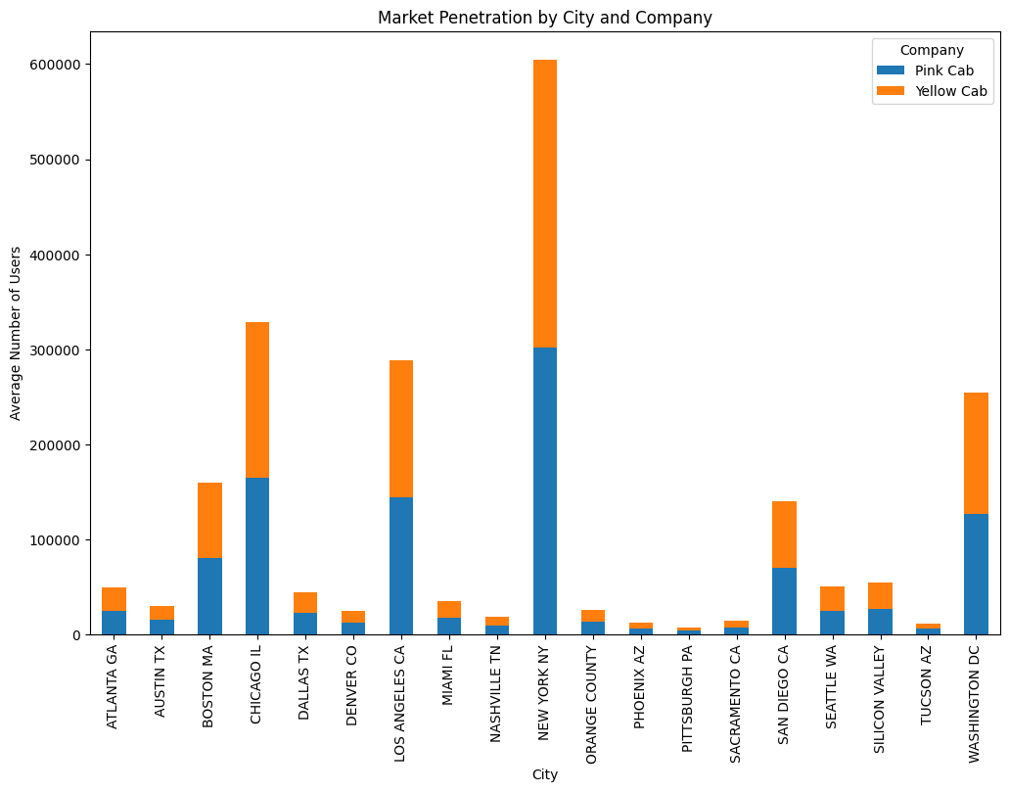
Yellow Cab's higher market penetration suggests a stronger brand presence and customer preference in various locations.

Slide 13
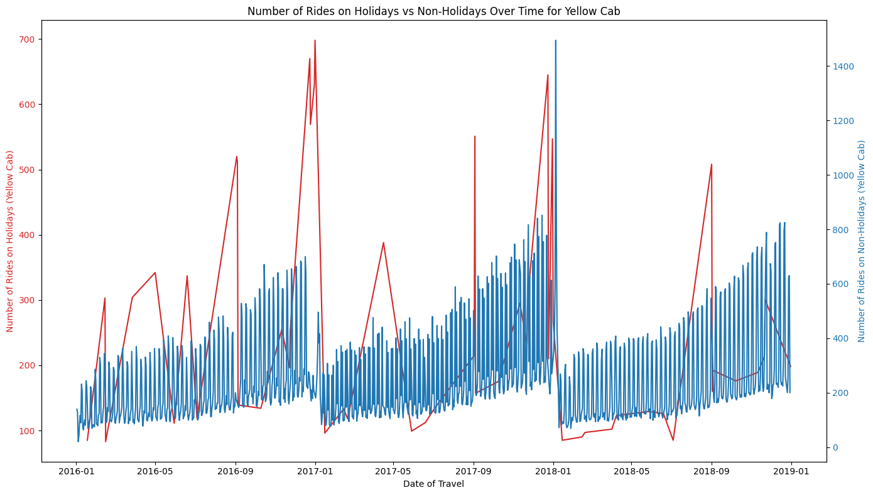
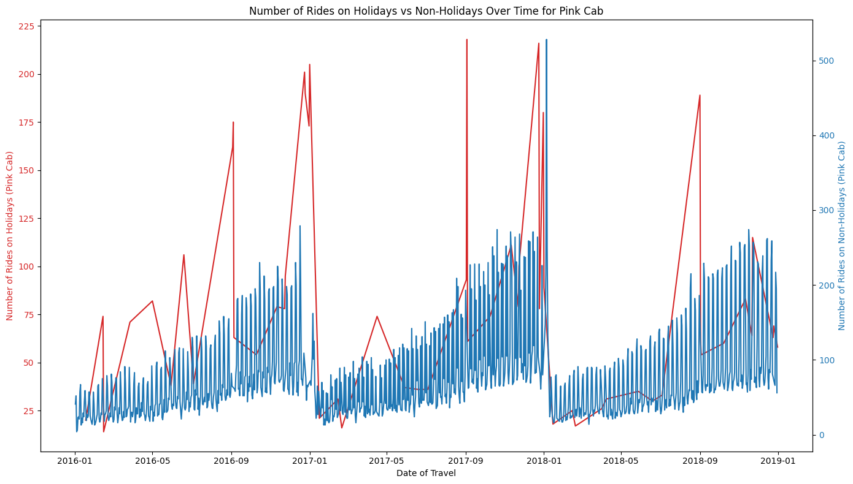
Both companies experience increased ride demand on holidays, but Yellow Cab consistently has higher ride numbers, indicating a stronger ability to capitalize on holiday demand.

Slide 14
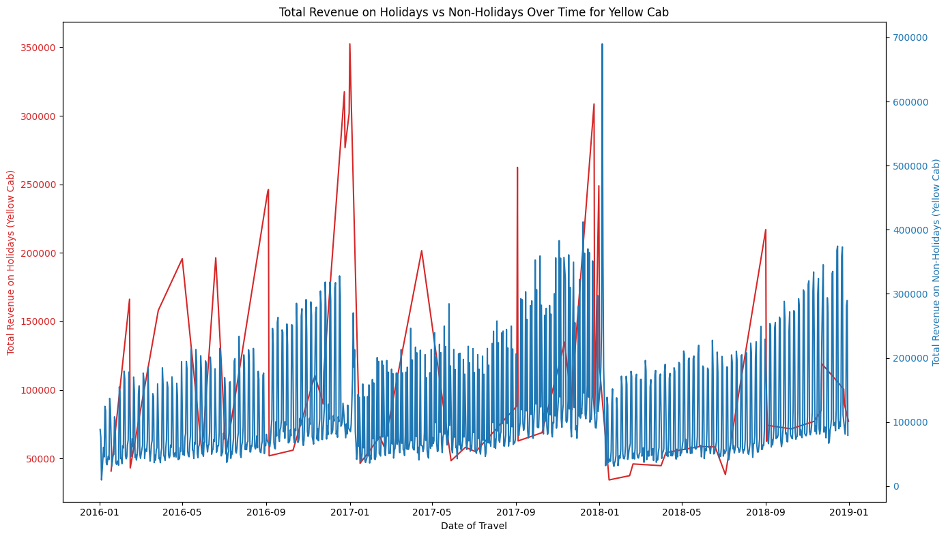
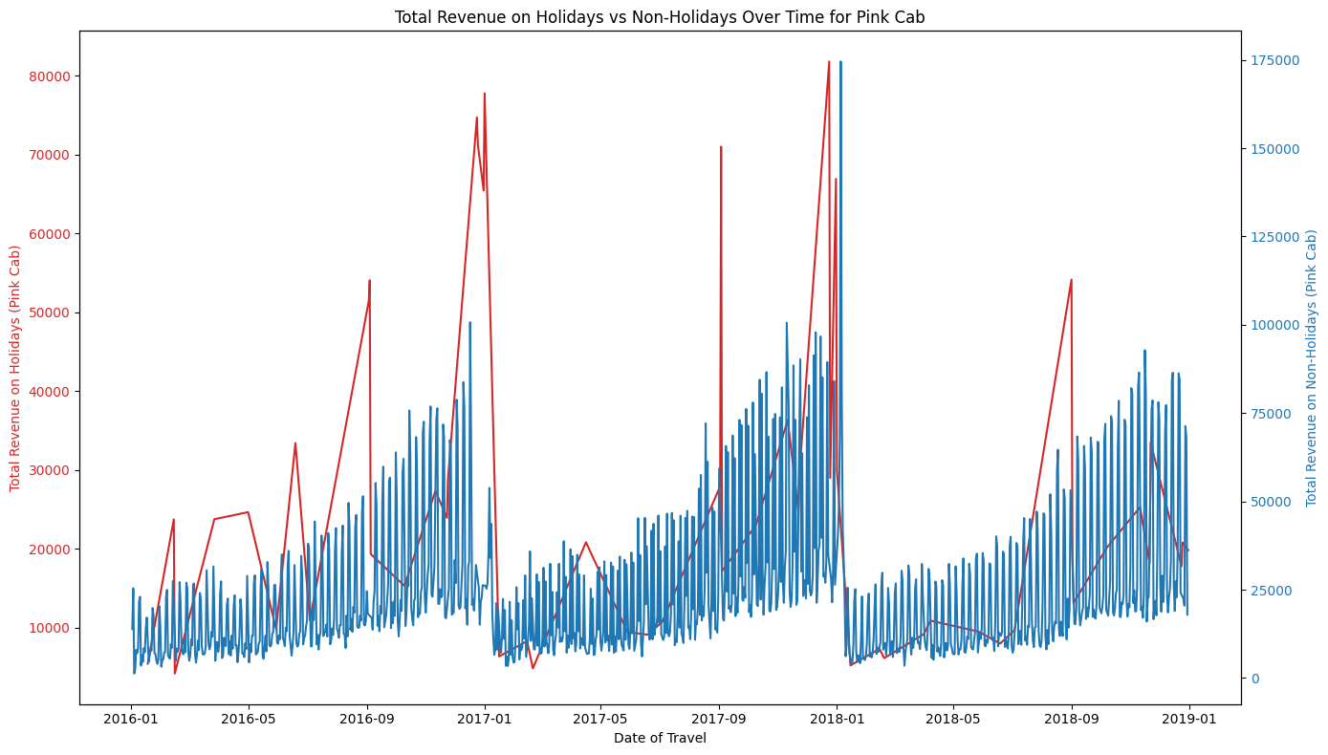
From the noticable peaks, both companies generate higher revenue on holidays, but Yellow Cab has a stronger revenue performance overall. This indicates a better ability to capture holiday traffic and maintain strong revenue streams on regular days.

Slide 15
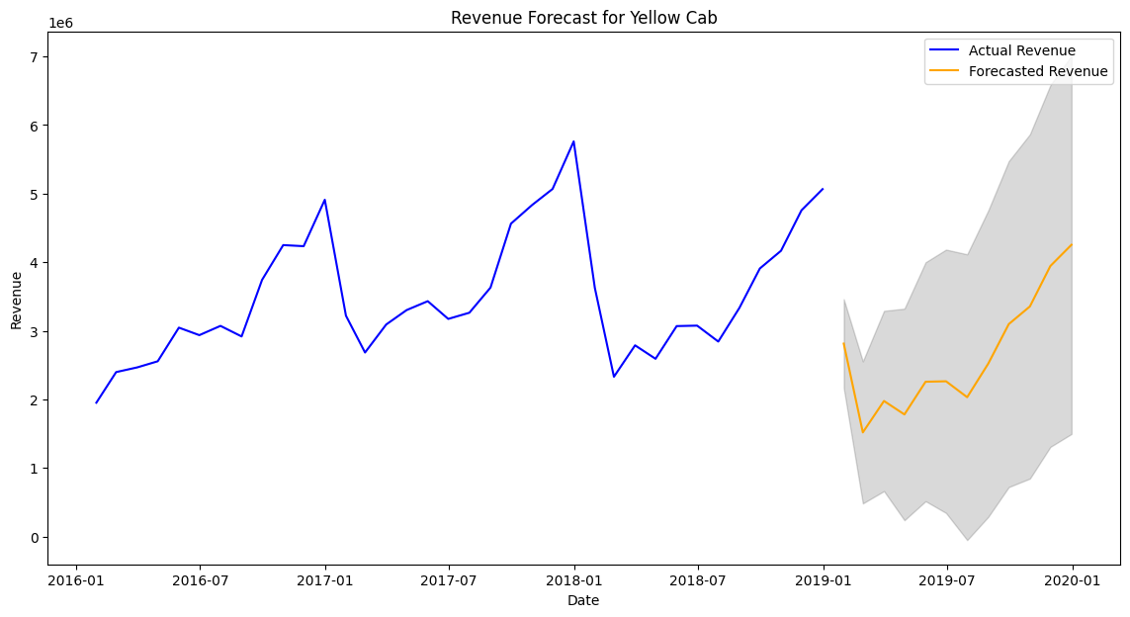
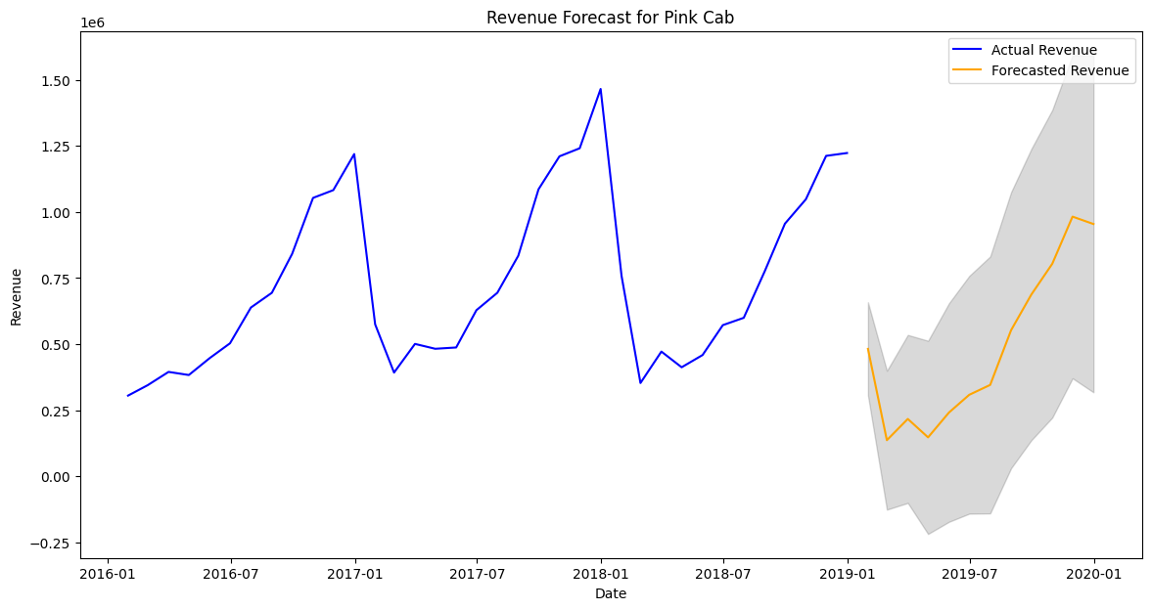
Forecasting Insights: The revenue forecasts for both Yellow Cab and Pink Cab indicate continued growth, with Yellow Cab showing a more pronounced upward trend. This is consistent with their historical performance and market dominance. Pink Cab also shows positive growth, albeit at a slower rate.

Slide 16
EDA Summary
Demographic Insights:
Yellow Cab serves a broader age and income range compared to Pink Cab.
Both companies have a similar gender distribution, with a slight male predominance.
Usage Patterns:
Yellow Cab has a higher number of rides and better market penetration in most major cities.
The impact of holidays on rides and revenue is more pronounced for Yellow Cab.
Performance Metrics:
Yellow Cab generates higher revenue and profit margins but is less cost-efficient than Pink Cab.
Pink Cab is more cost-efficient per kilometer traveled.
Outlier Analysis:
Boxplots reveal that Yellow Cab has higher, more variable prices, costs, and profits, with more outliers compared to Pink Cab. Pink Cab is more consistent but shows occasional negative profits, suggesting operational improvements are needed. Both companies have similar kilometers traveled, indicating differences primarily in pricing and cost structures.

Slide 17
Hypothesis Testing:
To validate our findings, we performed several statistical tests:
Revenue Comparison: Yellow Cab generates higher revenue than Pink Cab on both holidays and non-holidays.
Profit Margin: Yellow Cab has a higher average profit margin.
Cost Efficiency: Pink Cab has lower cost per km traveled.
Market Penetration: Yellow Cab has higher market penetration in major cities.
Customer Income: Yellow Cab serves a broader income range.
Profit Variability: Yellow Cab shows greater variability in profit.
Negative Profits: Pink Cab has more negative profit instances.

Slide 18
Recommendations
Investment Decision:
From the Analysis, XYZ should consider investing in Yellow Cab to leverage its strong market performance and profitability. The company demonstrates higher revenue generation and profitability, capturing market demand effectively, especially during holidays, leading to increased revenue. Additionally, the higher average profit margin indicates more efficient operations or pricing strategies.
Strategic Suggestions:
For Yellow Cab: Improve cost efficiency by optimizing operations.
For Pink Cab: Expand market presence in major cities and explore strategies to increase customer base.
Implement dynamic pricing strategies to maximize revenue during peak times and holidays.
Utilize targeted marketing campaigns to attract more high-income customers.
Future Analysis:
For further investigation, I suggest customer satisfaction surveys and competitor analysis should be carried out to gain more insights

Slide 19

Thank You

